Slide 1
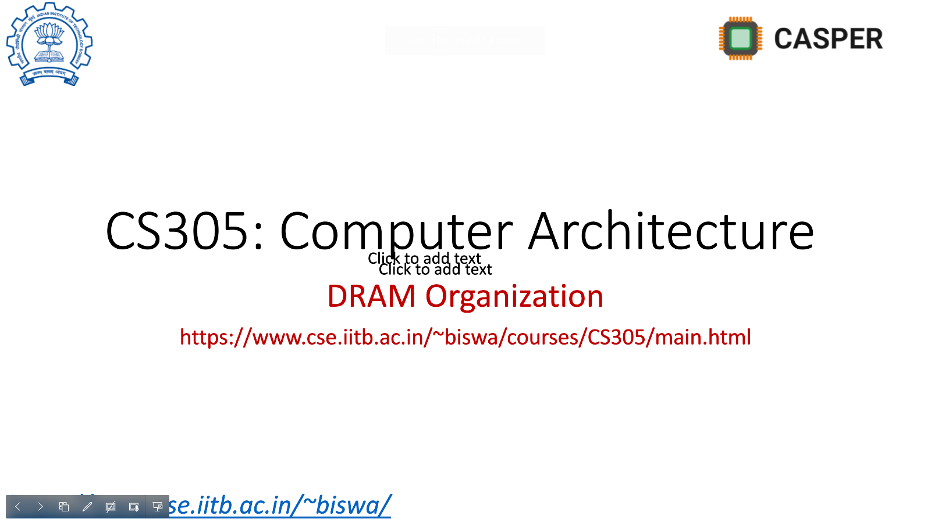
Quantifying Hardware Prefetching metrics of interest
MS R&D - 1
Sumon Nath
(21q050007)
sumon@cse.iitb.ac.in

Slide 2
Topics to cover
Background on prefetchers & metrics of interest
Simulation software
Effect of lateness
Impact of DRAM bandwidth
Interaction with cache replacement policies

Slide 3
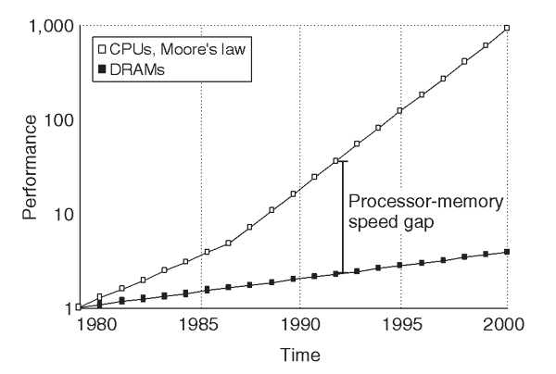
Memory wall
55% growth rate
10% growth rate

Slide 4

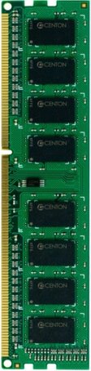
Memory wall
CORE
DRAM Controller
100’s of cycles

Slide 5
Latency tolerance techniques
Out-of-order execution
Multithreading
Caching
Prefetching

Slide 6
Hardware Prefetching
HIT
X + 3
3
X + 3
5
CORE
Cache
data
4
X + 2
X + 1
X
X + 3
1
Prefetcher
2

Slide 7
Hardware prefetching
Idea
Fetch the data before it is needed by program
Latency hiding technique
How?
By observing/predicting the demand access patterns.
Why?
High memory latency up to 400 – 800 cycles
Can eliminate Compulsory misses
Reduces cache miss rate
Reduces miss penalty

Slide 8
State-of-the-art prefetchers
Bingo¹
SPP²
IPCP³
[1] M. Bakhshalipour, M. Shakerinava, P. Lotfi-Kamran and H. Sarbazi-Azad, "Bingo Spatial Data Prefetcher," 2019 IEEE International Symposium on High Performance Computer Architecture (HPCA), 2019
[2] J. Kim, S. H. Pugsley, P. V. Gratz, A. L. N. Reddy, C. Wilkerson and Z. Chishti, "Path confidence based lookahead prefetching," 2016 49th Annual IEEE/ACM International Symposium on Microarchitecture (MICRO), 2016
[3] S. Pakalapati and B. Panda, "Bouquet of Instruction Pointers: Instruction Pointer Classifier-based Spatial Hardware Prefetching," 2020 ACM/IEEE 47th Annual International Symposium on Computer Architecture (ISCA), 2020.

Slide 9
Prefetcher of interest: IPCP³
A bouquet of prefetchers
First IP prefetcher: Constant stride
Second IP prefetcher: Complex stride
Third IP prefetcher: Global stream
Fourth prefetcher: Next-line
Best performing prefetcher

Slide 10
Metrics of interest
Accuracy
Used prefetches / total prefetches
Coverage
Misses eliminated by prefetching / total misses
Timeliness
How early/late a prefetch is?
Late prefetch

Slide 11
Topics to cover
Background on prefetchers & metrics of interest
Simulation software
Effect of lateness
Impact of DRAM bandwidth
Interaction with cache replacement policies

Slide 12
Simulation software – Champsim⁴
Open source simulation software
Trace-based simulator
Trace: File that contains information about what the instructions perform and the number of cycles needed to complete their execution.
Trace generated using – Pin Tool⁵
[4] https://github.com/ChampSim/ChampSim
[5] https://www.intel.com/content/www/us/en/developer/articles/tool/pin-a-dynamic-binary-instrumentation-tool.html

Slide 13
Process of running Champsim
Program
PIN
Trace
Champsim
Results
Code to be run on Champsim
Simulation

Slide 14
Topics to cover
Background on prefetchers & metrics of interest
Simulation software
Effect of lateness
Impact of DRAM bandwidth
Interaction with cache replacement policies

Slide 15
What is a Late prefetch?
Miss-status holding register (MSHR)
Enables multiple misses in parallel
CORE
Cache
Prefetcher

Slide 16
What is a Late prefetch?
Late prefetch
MSHR
MISS
X + 3 [P]
3
X + 3
4
CORE
Cache
X + 2
X + 1
X
X + 3
1
Prefetcher
2

Slide 17
Lateness
Lateness - % of late prefetches
Why a problem?
Accurate but late
Cannot hide the whole memory latency
Room for improvement
What happens if DRAM bandwidth is constrained?

Slide 18
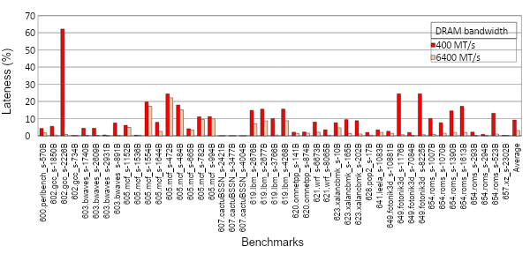
Lateness in IPCP [SPEC CPU benchmarks]
lateness – 10 % on average (low bandwidth)
As high as 63%

Slide 19
Expectation
If late prefetches eliminated (on-time)
- Significant performance improvement

Slide 20
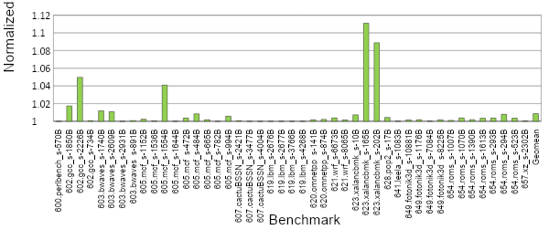
Reality
DRAM BW: 400 MT/s
Geomean : 0.8 % improvement
Fig: Performance improvement of IPCP when late prefetches are eliminated on SPEC2017 benchmarks

Slide 21
Why insignificant improvement?
Out-of-order
100 cycles
LOAD
2. SUB
3. LOAD
4. LOAD
5. MUL
LOAD
2. SUB
3. LOAD
4. LOAD
5. MUL
15 cycles
20 cycles
3 cycles
2 cycles
In-order Instruction Fetch
Out-of-order execution
In-order Commit

Slide 22
Why insignificant improvement?
Out-of-order
20 cycles
LOAD
2. SUB
3. LOAD
4. LOAD
5. MUL
LOAD
2. SUB
3. LOAD
4. LOAD
5. MUL
15 cycles
20 cycles
3 cycles
2 cycles
In-order Instruction Fetch
Out-of-order execution
In-order Commit

Slide 23
Why insignificant improvement?
In-order
Out-of-order
In-order
Issue Queue
Reorder Buffer
Commit
Execute
Issue queue
F1 |  | Add ..
F0 |  | load …
Newest
ROB7
ROB6
ROB5
Actual ROB size : 350 entries
ROB4
ROB3
Reorder Buffer
ROB2
ROB1
Oldest
ROB head

Slide 24
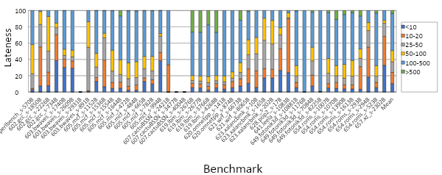
Lateness by # of cycles
cycles
< 4% of late prefetches are late by > 500 cycles
Fig: Percent of late prefetches by # of cycles of IPCP on SPEC2017 benchmarks

Slide 25
Topics to cover
Background on prefetchers & metrics of interest
Simulation software
Effect of lateness
Impact of DRAM bandwidth(BW)
Interaction with cache replacement policies

Slide 26
Why care about DRAM BW?
Servers – Multicore system
32 cores
DRAM BW per channel – 3200 MT/s
4 available channels
1 channel for 8 cores
On average per core DRAM BW
– 400 MT/s(3.2 GB/s)

Slide 27
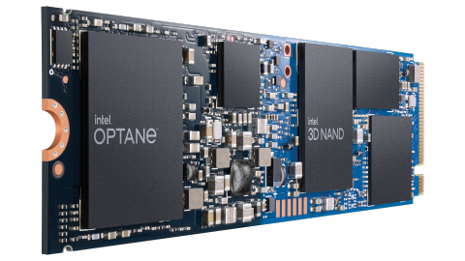
Why care about DRAM BW?
Non volatile memory – Intel Optane
Fastest NVMs
read – 3 GB/s = 375 MT/s
write – 1 GB/s = 125 MT/s

Slide 28
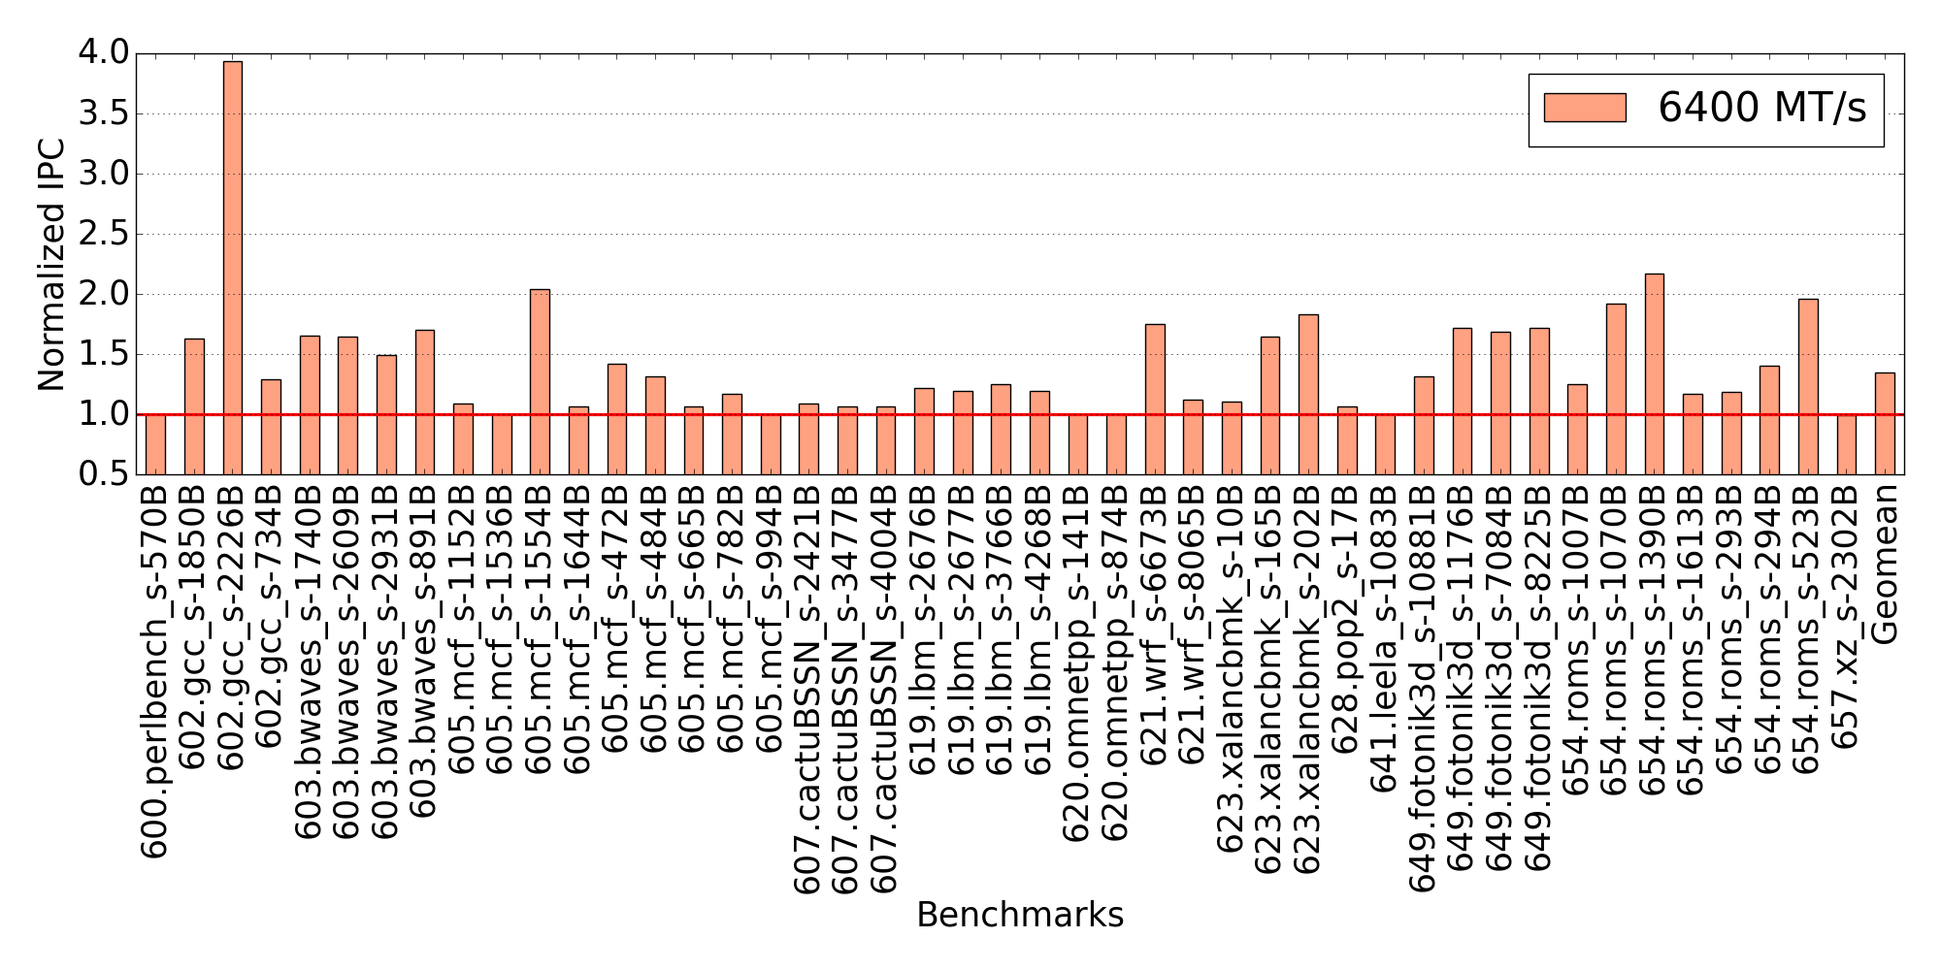
IPCP performance(high DRAM BW)
Overall improvement: 35 %
Fig: Performance improvement with IPCP on SPEC2017 benchmarks compared to no prefetching baseline

Slide 29
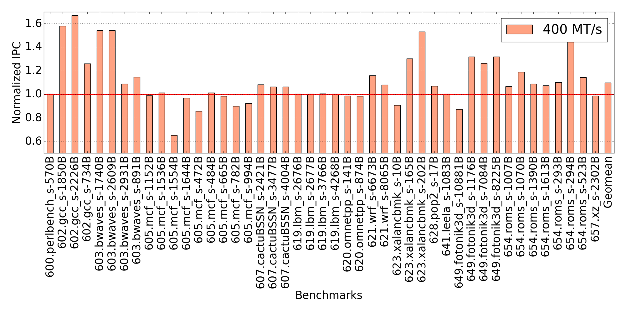
IPCP performance(low DRAM BW)
Overall improvement: 10 %
Fig: Performance improvement with IPCP on SPEC2017 benchmarks compared to no prefetching baseline

Slide 30
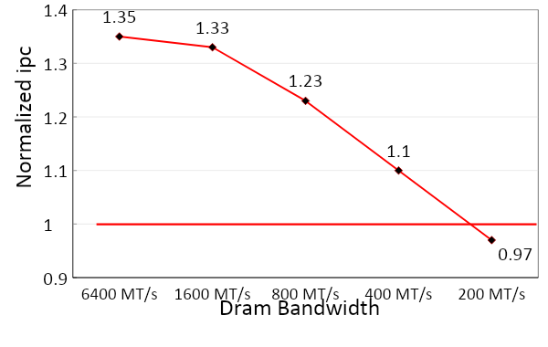
Impact of DRAM BW on performance
Significant performance drop as DRAM BW decreases
Performance degradation in case very low DRAM BW
NOPE⁶
Turn OFF prefetching when performance degrades with low DRAM BW
[6] Anuj Mishra and Biswabandan Panda, “Hardware Prefetcher Aggressiveness Controllers: Do We Need Them All the Time?”, ASPLOS 2021, Workshop on Negative results, Opportunities, Perspectives, and Experiences

Slide 31
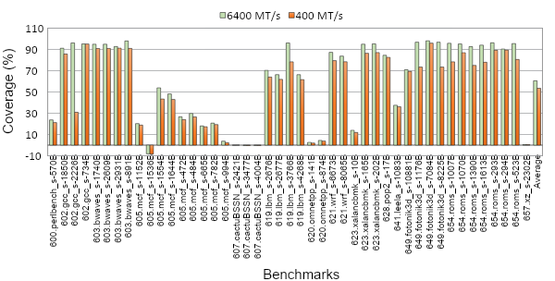
Impact on prefetcher coverage
DRAM BW:
Coverage drops from 61 % to 53 %.
Fig: Comparison of prefetcher coverage at the L1D with IPCP on SPEC2017 benchmarks for low & high DRAM BW

Slide 32
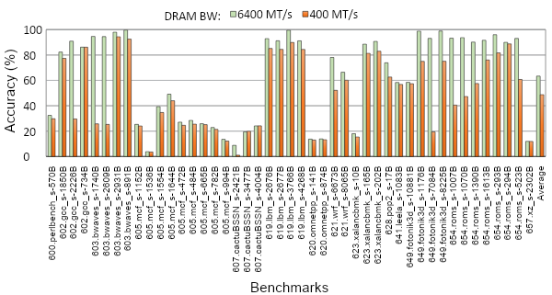
Impact on prefetcher accuracy
Accuracy drops from 63.5 % to 48 %.
Less useful prefetches
Lot of scope for improvement in case of constrained DRAM bandwidth
Fig: Comparison of prefetcher accuracy at the L1D with IPCP on SPEC2017 benchmarks for low & high DRAM BW

Slide 33
Topics to cover
Background on prefetchers & metrics of interest
Simulation software
Effect of lateness
Impact of DRAM bandwidth
Interaction with cache replacement policies

Slide 34
Why cache replacement policies?
Prefetchers – brings in cache block
Replacement policies – evicts a cache block
Must work in unison to improve performance
State-of-art prefetchers - No interaction

Slide 35
Cache replacement policies used
Re-Reference Interval Prediction(RRIP⁷)
Static RRIP (SRRIP⁷)
Dynamic RRIP (DRRIP⁷)
Prefetch-Aware Cache Management (PACMAN⁸)
[7] Aamer Jaleel, Kevin B. Theobald, Simon C. Steely, and Joel Emer, “High performance cache replacement using re-reference interval prediction (RRIP)”, ISCA’10
[8] C. Wu, A. Jaleel, M. Martonosi, S. C. Steely and J. Emer, "PACMan: Prefetch-Aware Cache Management for high performance caching," 2011 44th Annual IEEE/ACM International Symposium on Microarchitecture (MICRO), 2011

Slide 36
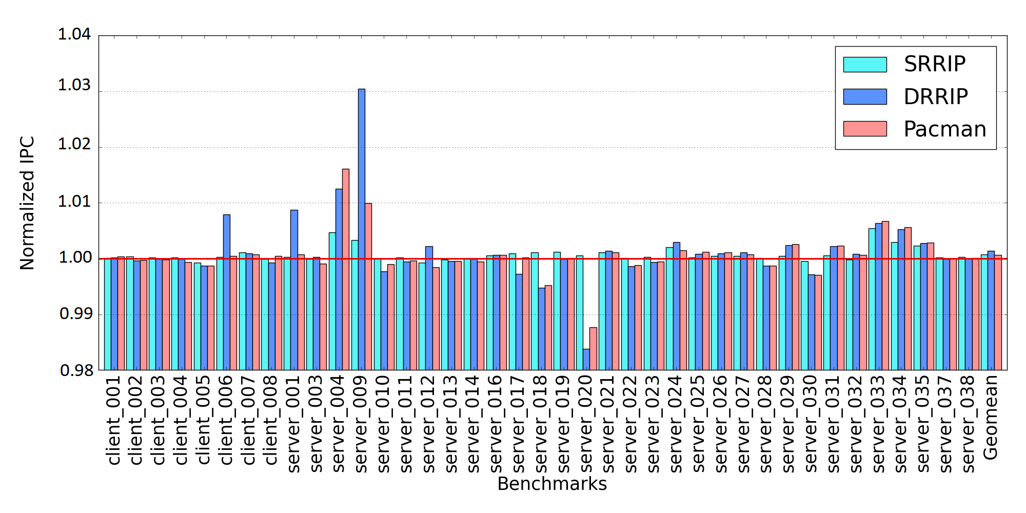
IPCP performance(client-server)- L1
No significant performance improvement
Fig: Performance improvement of IPCP with different cache replacement policies at the L1 compared to a baseline with LRU policy

Slide 37
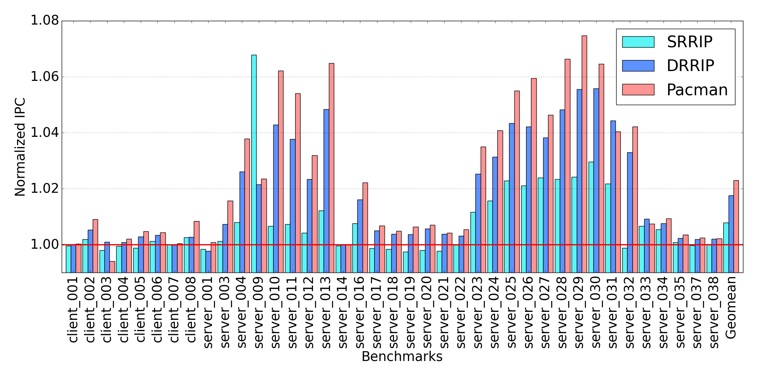
IPCP performance(client-server)- L2C
Significant performance improvement across server benchmarks
Max. improvement for Pacman – 7.5 %
On Average – 2.5 % improvement for Pacman
Fig: Performance improvement of IPCP with different cache replacement policies at the L2C compared to a baseline with LRU policy

Slide 38
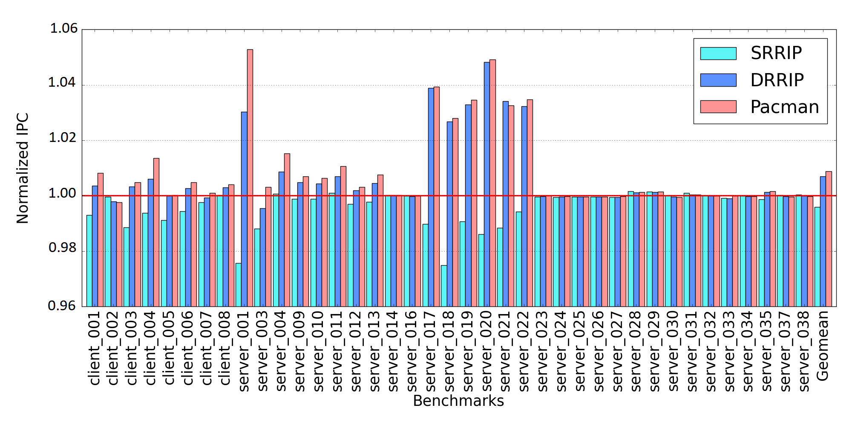
IPCP performance(client-server)- LLC
Max. improvement for Pacman – 5.5 %
On Average – 1 % improvement for Pacman
Fig: Performance improvement of IPCP with different cache replacement policies at the LLC compared to a baseline with LRU policy

Slide 39
Champsim code
Already Implemented:
IPCP
Identification of late prefetches
SRRIP, DRRIP
Implementations for R&D work:
Elimination of late prefetches
Lateness by # of cycles
Pacman

Slide 40
Conclusion & future work
Lateness is not an issue for IPCP, but needs further study.
Significant performance degradation for low dram bandwidth
Replacement policies play a crucial role on prefetcher performance
Cache pollution – in progress

Slide 41
Acknowledgements
Some of the slides are adapted and modified from Prof. Biswabandan Panda, Prof. Onur Mutlu and my senior Rajiv.

Slide 42
Thank You

